Slide 1
Developer Performance tracking System
Project Team:- Umeaz Kheradia Kshitij Kaushik Priyabrata Purohit Pooja Gaikwad Apoorva Joshi Sandeep Kumar

Slide 2
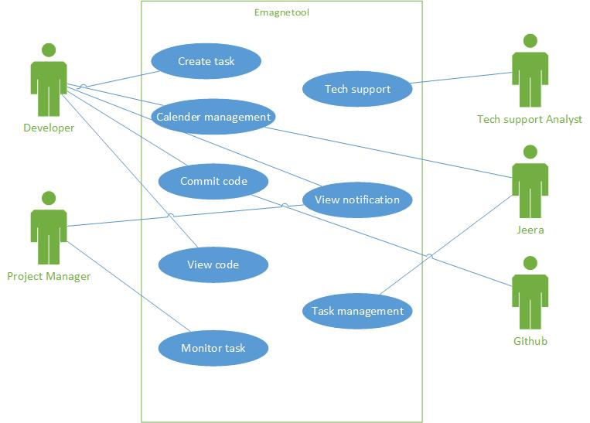
Use Case High Level View

Slide 3
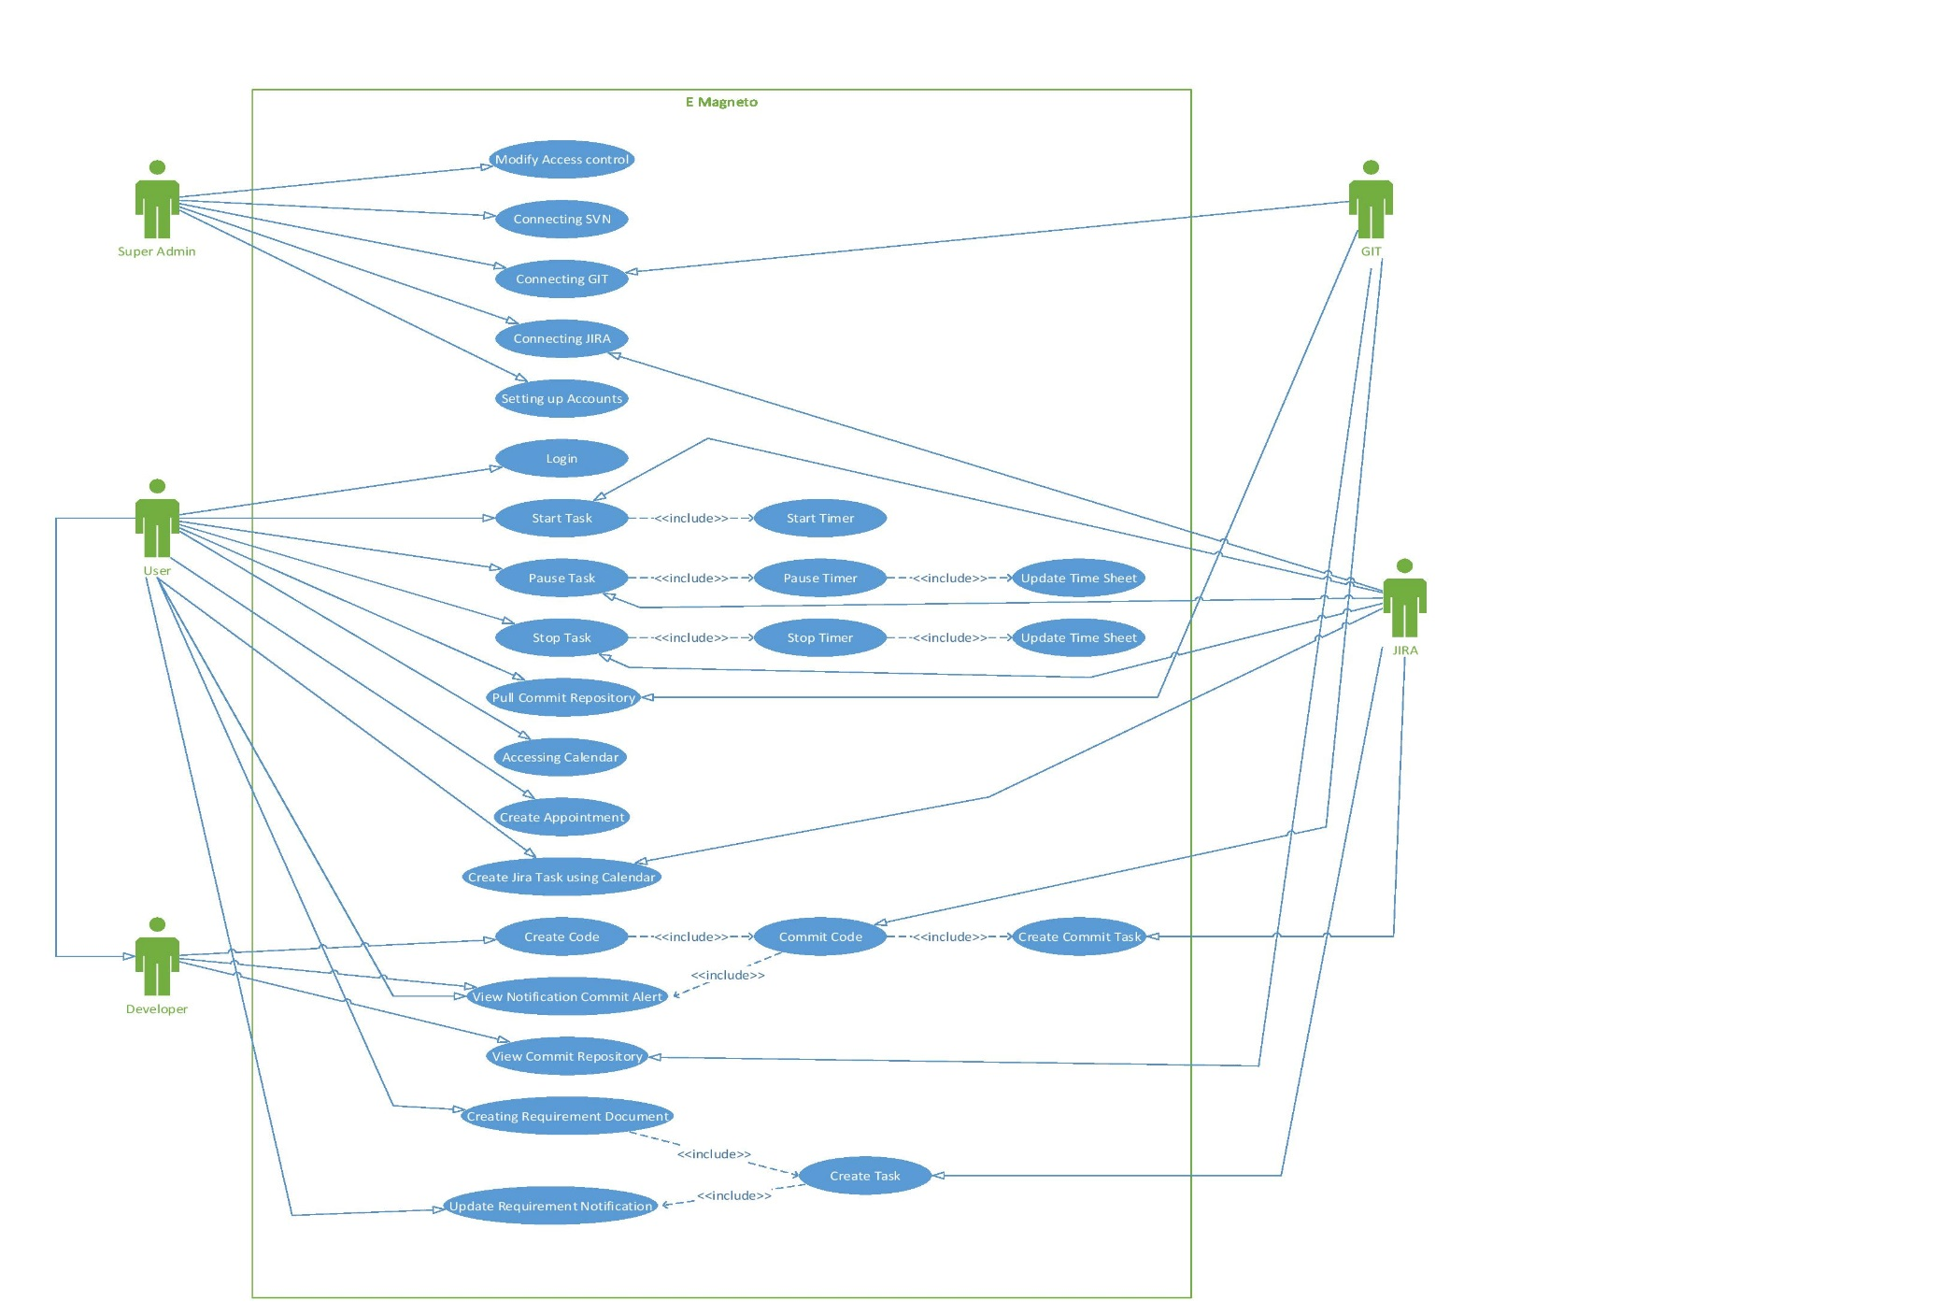
Use Case Diagram Extended View

Slide 4
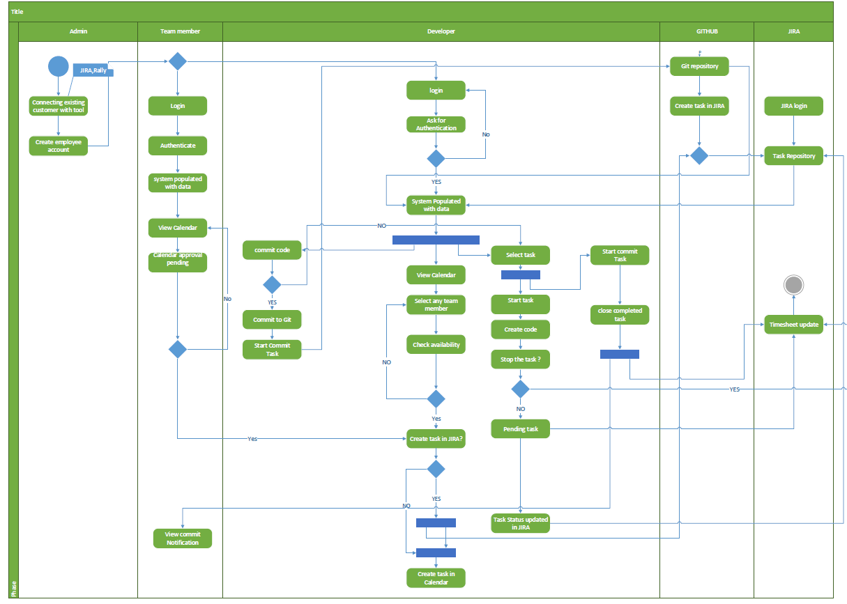
Activity Diagram

Slide 5
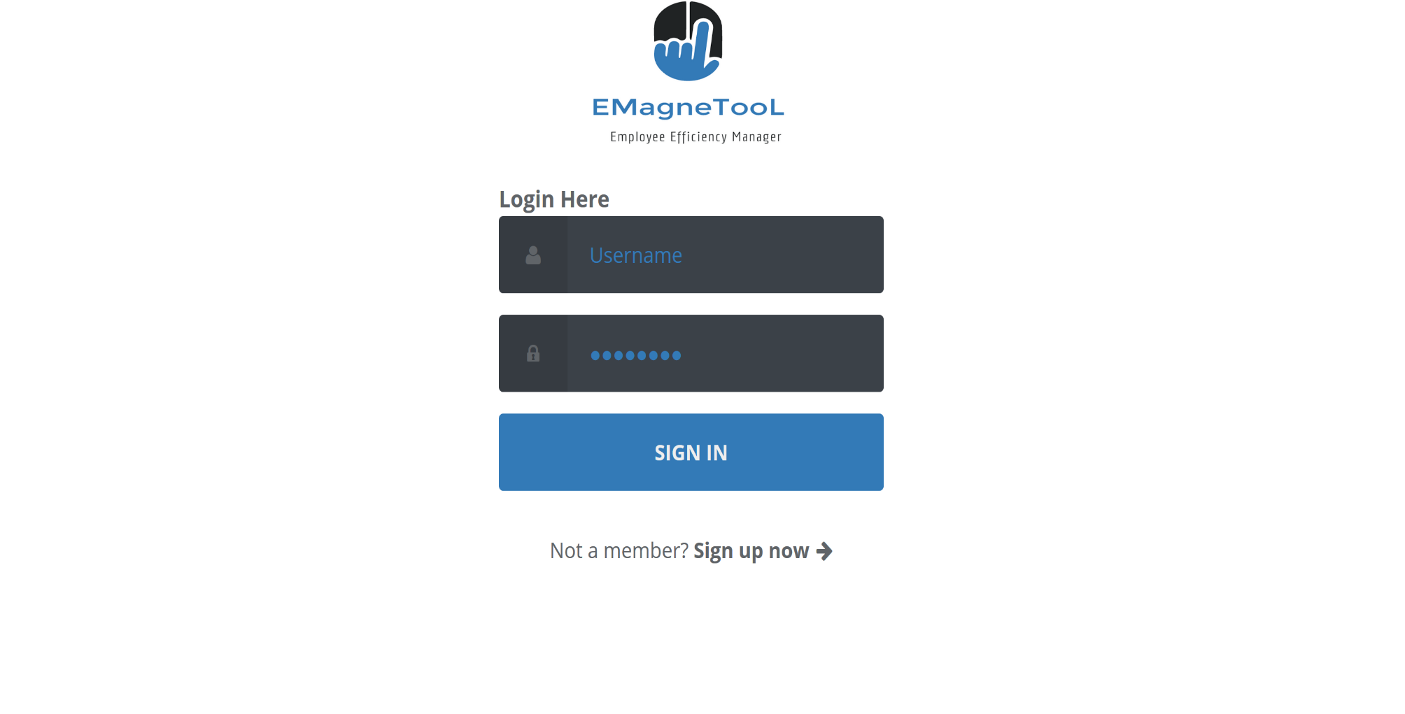
UI Design –Login Page

Slide 6
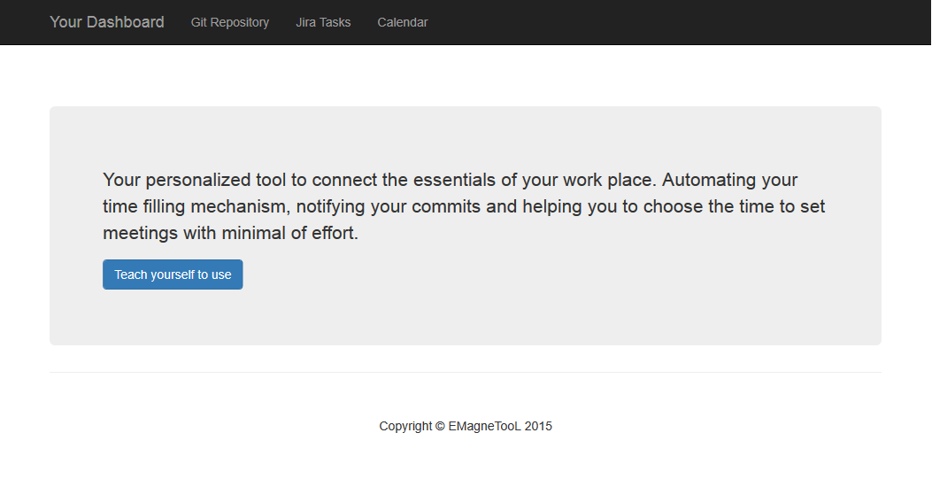
Home Page

Slide 7
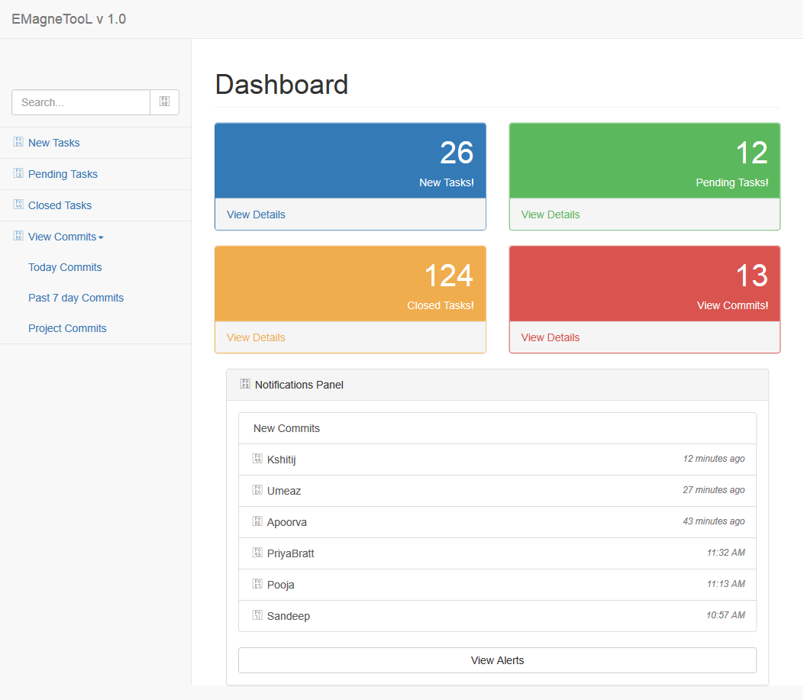
Dashboard

Slide 8
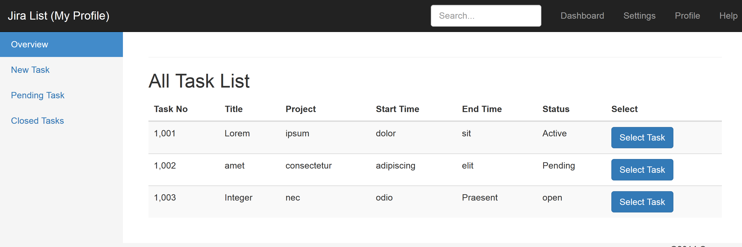
JIRA

Slide 9
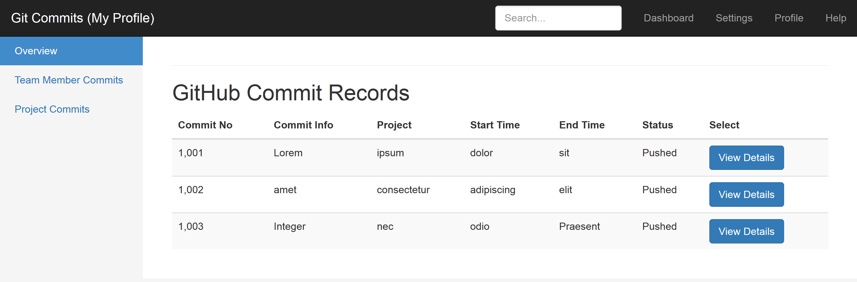
GitHub

Slide 10
Thank You

